Slide 1
UFC FIGHT ANALYSIS
1993 TO 2019
Author: Christian Hartler

Slide 2
Objective of the analysis
Determining what are the major features to look in a UFC fighter by answering following questions:
Who has won the most title fights?
What is the most determining factor for winning a fight?
How does align with the fighter’s longest winning streak?
How does this factor compare to the sum of won fights?
Can we safely use this factor to determine the outcome of fights?

Slide 3
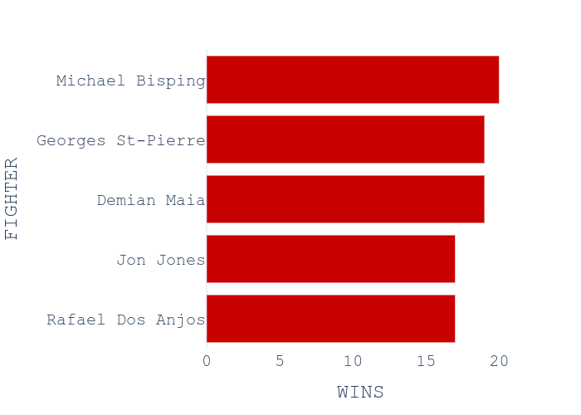
Title wins & win determining factor
Overall model analysis of won fights show many different factors to determine a win with a prediction accuracy of 65 %
Most imporant factors were
Both fighter’s AGE
And how many different strikes the winning fighter endured

Slide 4
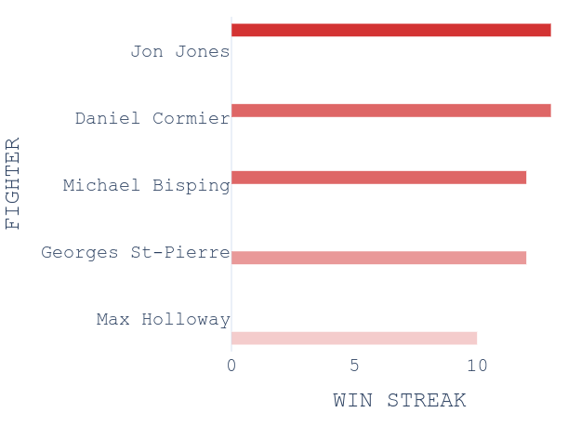
Fight streaks per age
Fighter’s with the longest win streaks in a row vary between the age of 25 and 30 and are comparable to the biggest title fighters Jon Jones and Michael Bisping
Jon Jones (Age: 30)
Daniel Cormier (Age: 38)
Michael Bisping (Age: 38)
Georges St-Pierre (Age: 36)
Max Holloway (Age: 25)

Slide 5
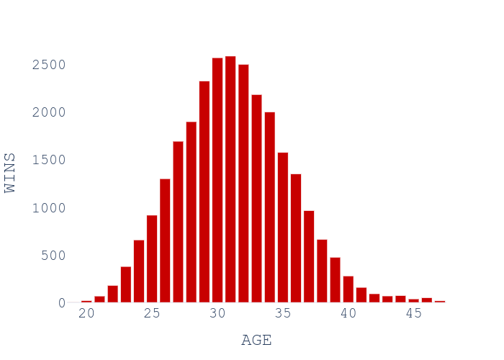
Age to won fights
Further analysis for fighter’s age reveal that the fighter’s prime is between the age 29 to 33

Slide 6
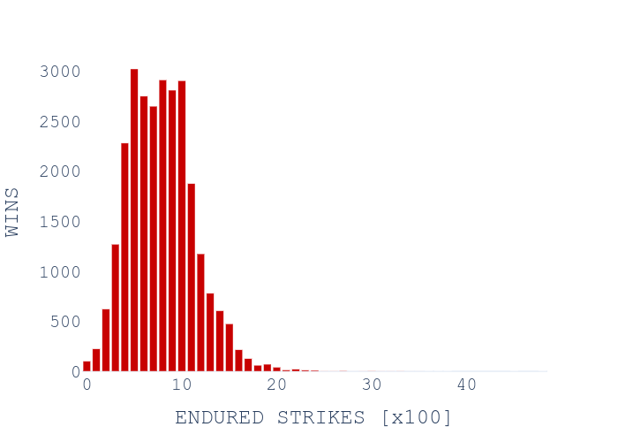
Endured strikes to won fights
The strikes that the fighter received during his career seem to have also an impact, which can be related to the fighter’s experience

Slide 7
Summary and outlook
The most determining features for a fight are Age & Experience of the fighter
The used models only have a prediction accuracy of 65 %, which is not enough to safely predict the outcome of a fight
This can be related to the many features that need to be considered in a fight
Further analysis is necessary but a higher prediction accuracy is unlikely due to the amount of fight determining factors

Slide 8

“Life's not about how hard of a hit you can give... it's about how many you can take, and still keep moving forward.”
― Sylvester Stallone, Rocky Balboa

